Slide 1
Modul 5b XML
Session 2, 18-11-2020
Dr. Jaap Geraerts

Slide 2
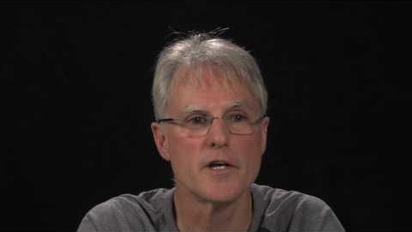
XPath and XSLT

Slide 3
XPath
Discovering information in XML files
Using ‘paths’ to navigate the hierarchical structure of XML files
Selection of:
Nodes (e.g. elements, attributes)
Predicates (e.g. particular node, or node with specific value)

Slide 4
XPath syntax (nodes)
cookbook = select nodes with the name ‘cookbook’
/cookbook/recipe/ingredients = select all occurrences of the child element ‘ingredients’
//ingredients = find all ‘ingredients’ elements, no matter where located in the structure

Slide 5
XPath syntax (predicates)
/cookbook/recipe[1]/ingredients = select all occurrences of the child element ‘ingredients’ of the first recipe
/cookbook/recipe[2]/ingredients[4] = select the fourth instance of the child element ‘ingredients’ of the second recipe
//ingredients[contains(@name, "ggs")]

Slide 6
XPath exercise
Open the file ‘XPath_session2.xml’
Try to find the following information:
1) All the instances of the person with the name ‘Romulus’
2) All the curved underscores and the Mercury symbols. Hint: use the elements <underline> and <symbol>
3) The translated text of the last marginal note in this file. Hint: use the elements <marginalia> and <translation>
For useful information, see here and here

Slide 7
XSL/XSLT
eXtensible Stylesheet Language (Transformations)
CSS for XML
Used to transform information, for example:
XML to HTML
XML to XML (e.g. expressing data according to another schema)

Slide 8
XSLT syntax (1)
XML declaration: <?xml version="1.0" encoding="UTF-8"?>
XSL declaration (two versions!):
<xsl:stylesheet version="1.0" xmlns:xsl="http://www.w3.org/1999/XSL/Transform">
<xsl:transform version="1.0" xmlns:xsl="http://www.w3.org/1999/XSL/Transform">
Link to XSL file in XML document:
<?xml-stylesheet type="text/xsl" href="cdcatalog.xsl"?>

Slide 9
XSLT syntax (2)
Finding and transforming data in XML files
Template element <xsl:template match="/">
Various functions
Value-of element <xsl:value-of select="/Path"/>
For-each element <xsl:for-each select="/Path"/>
Sort element <xsl:sort select="name of element"/>
If element <xsl:if test="value_of">

Slide 10
XSLT syntax (3)
Choose function
Choose element <xsl:choose>
<xsl:choose> <xsl:when test="expression"> ... some output ... </xsl:when> <xsl:otherwise> ... some output .... </xsl:otherwise> </xsl:choose>

Slide 11
XSLT examples
A short live demonstration of XSLT in action in Oxygen
Example 1: Session 2_example1.xml; Recipe_XSLT.xsl
Example 2: Session 2_example2.xml; Recipe_XSLT_example2.xsl
Example 3: Recipe_XSLT_example_AOR.xsl; Session 2_example_XSLT.xml

Slide 12
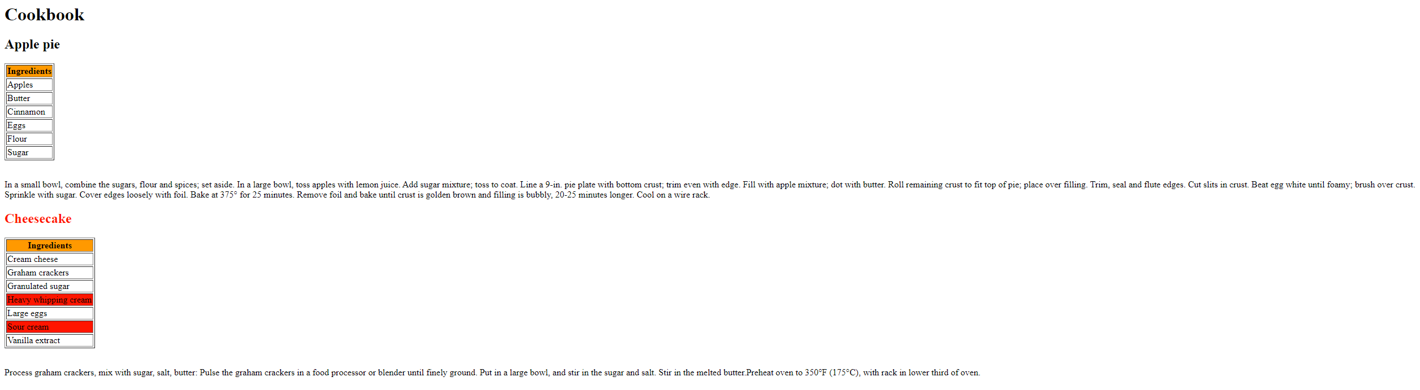
XSLT exercise
Modify the XSLT file ‘Recipe_XSLT_example2.xsl’ so that the name of the dish (e.g. Apple pie) is displayed in red if the recipe contains cream

Slide 13
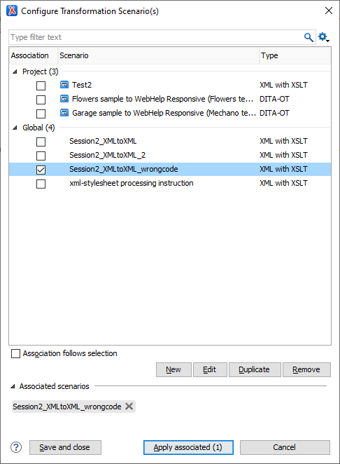
From XML to XML
Link to XSL file in the XML file (Document’/’XML document’/’Associate XSLT/CSS Stylesheet’)
In XML file, go to the Oxygen menu:
Document’/’XML document’/’Configure transformation scenario(s)’)

Slide 14
Change name of an element and add attribute
<xsl:stylesheet version="3.0" xmlns:xsl="http://www.w3.org/1999/XSL/Transform"> <xsl:output method="xml" encoding="utf-8"/>
<!-- identity transform: copy all attributes and elements--> <xsl:template match="@*|node()"> <xsl:copy> <xsl:apply-templates select="@*|node()"/> </xsl:copy> </xsl:template> <xsl:template match="recipe"> <!--match original element in XML file--> <xsl:element name="Jaaps_recipe"> <!--new name of the element-> <xsl:attribute name="name"><xsl:value-of select="@name" /></xsl:attribute> <!--name attribute and use value from original name attribute--> <xsl:attribute name="date"/> <!--associate new attribute-> <xsl:apply-templates/> </xsl:element> </xsl:template> </xsl:stylesheet>
See files: Recipe_XMLtoXML.xsl; Session2_XMLtoXML.xml

Slide 15
Add a child element
<xsl:stylesheet version="3.0" xmlns:xsl="http://www.w3.org/1999/XSL/Transform"> <xsl:output method="xml" encoding="utf-8"/>
<!-- identity transform: copy all attributes and elements--> <xsl:template match="@*|node()"> <xsl:copy> <xsl:apply-templates select="@*|node()"/> </xsl:copy> </xsl:template> <xsl:template match="recipe"> <xsl:copy> <!-- copy function--> <xsl:copy-of select="@*"/> <!-- copy all attributes--> <xsl:copy-of select="node()"/> <!-- copy all elements-> <xsl:element name="Equipment">Oven </xsl:element> <!– add element with value ‚Oven‘-> </xsl:copy> </xsl:template> </xsl:stylesheet>
See file: Recipe_XMLtoXML.xsl (comments)

Slide 16
Add a child element to a specific recipe
<xsl:stylesheet version="3.0" xmlns:xsl="http://www.w3.org/1999/XSL/Transform"> <xsl:output method="xml" encoding="utf-8"/>
<!-- identity transform: copy all attributes and elements--> <xsl:template match="@*|node()"> <xsl:copy> <xsl:apply-templates select="@*|node()"/> </xsl:copy> </xsl:template> <xsl:template match="recipe[@name='Cheesecake']"> <xsl:copy> <!-- copy function--> <xsl:copy-of select="@*"/> <!-- copy all attributes--> <xsl:copy-of select="node()"/> <!-- copy all elements-> <xsl:element name="Equipment">Oven </xsl:element> <!– add element with value ‚Oven‘ to the recipe with the name ‚Cheesecake‘-> </xsl:copy> </xsl:template> </xsl:stylesheet>
See files: Recipe_XMLtoXML_1.xsl; Session2_XMLtoXML_1.xml

Slide 17
Transform attribute to child element (1)
<xsl:stylesheet version="3.0" xmlns:xsl="http://www.w3.org/1999/XSL/Transform"> <xsl:output method="xml" encoding="utf-8" indent="yes"/> <xsl:template match="@*|node()"> <xsl:copy> <xsl:apply-templates select="@*|node()"/> </xsl:copy> </xsl:template> <xsl:template match="recipe"> <xsl:copy> <xsl:copy-of select="@*"/> <xsl:where-populated> <ingredients> <xsl:apply-templates select="ingredients"/> </ingredients> </xsl:where-populated> <xsl:apply-templates select="* except ingredients"/> </xsl:copy> </xsl:template> <xsl:template match="ingredients"> <name> <xsl:value-of select="@name"/> </name> </xsl:template> </xsl:stylesheet>
See files: Recipe_XMLtoXML2.xsl; Session2_XMLtoXML2.xml

Slide 18
Transform attribute to child element (2)
<xsl:stylesheet version="3.0" xmlns:xsl="http://www.w3.org/1999/XSL/Transform"> <xsl:output method="xml" encoding="utf-8"/> <xsl:template match="@*|node()"> <xsl:copy> <xsl:apply-templates select="@*|node()"/> </xsl:copy> </xsl:template> <xsl:template match="ingredients"> <xsl:element name="{name(@name)}"> <!--name of the element with the value of the name attribute--> <xsl:value-of select="@name"/> <!--value of the element with the value of the name attribute--> </xsl:element> </xsl:template> </xsl:stylesheet>
See files: Recipe_XMLtoXML_wrongcode.xsl; Session2_XMLtoXML_wrongcode.xml

Slide 19

TEI
Text Encoding Initiative
Community of practice (since 1980s)
Guidelines for the creation of machine-readable text
Focus on printed books
Latest guidelines: P5

Slide 20
TEI: advantages
Ready-made schema (no need to reinvent the wheel)
Very detailed and descriptive
Freely available
Customization, e.g. TEI Lite

Slide 21
TEI: disadvantages
Top-heavy (enormous header)
At times overly descriptive
Wants to cover everything…but doesn’t do so
XML = the standard, TEI = particular XML schema

Slide 22
Sources (Xpath)
Xpath playground: https://scrapinghub.github.io/xpath-playground/?utm_campaign=BRA&utm_activity=BLO&utm_medium=ORG&utm_source=HUB&utm_content=BLP
Xpath tutorial: https://blog.scrapinghub.com/2016/10/27/an-introduction-to-xpath-with-examples
https://teach.dariah.eu/course/view.php?id=32&section=6

Slide 23
Sources (XLST)
https://www.w3schools.com/xml/xsl_intro.asp
https://programminghistorian.org/en/lessons/transforming-xml-with-xsl
http://www.cs.toronto.edu/~ryanjohn/teaching/cscc43-s12/lectures/c43-xslt-v02.pdf
http://www.ag-nbi.de/lehre/07/V_XML/Folien/06_XSLT.pdf
http://dh.obdurodon.org/xslt-basics.xhtml, http://dh.obdurodon.org/xslt-basics-2.xhtml
https://www.freeformatter.com/xsl-transformer.html

